Slide 1
COMP 5800 Ubiquitous Computing 2017 Spring Final Project
Smart Refrigerator - can prevent foods from going bad
Instructor: Guanling Chen
Team Member:
Kaiwen Xu
Linghong Tang
Xin Su

Slide 2
Problem Statement
Food waste problem is usually due to improper food stored in the refrigerator, or hidden behind other objects so that they are forgotten till no longer fresh and smell bad.

Slide 3
Problem Statement
Background
With the rise of storage supermarket shopping culture, people now in order to save family expenses, always buy more food, but also wasted a lot of extra food. In fact, according to investigation, in 2012, Americans wasted about $ 165 billion of foods. On average, a family of four people wasting about $2300 of foods.
According to media reports, a waste of food, not only caused huge economic losses, but also caused unnecessary harm on the human survival of the natural environment! Throwing away food, causing large amounts of carbon emissions, producing greenhouse gases; throwing away food, causing waste of water; food waste, aggravating agricultural pressures and threatening biodiversity.

Slide 4
Problem Statement
Motivation
Our project in order to refuse to food waste, improve the quality of life, from make good use of the refrigerator.

Slide 5
Problem Statement
Introduction
Our project is made up of two parts
One is use gas detection sensor setting in the refrigerator then obtain change of gas (H₂S and C₂H₄), can connect with our smart phone by WIFI.
Another part come with a mobile application, through the phone camera to obtain food image texture and color characteristic value, also record the food expiration date.
With this two part, people can look at what food in their refrigerator at any moment through the phone and see the quality guarantee period information. In addition, once the sensors detect the food is going to decay, will send feedback information to mobile phones to remind people.

Slide 6
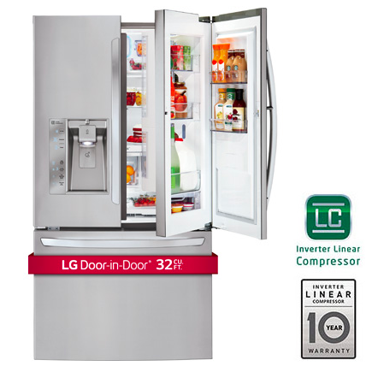
Related work
Some existing refrigerator in the market
LG Door-In Door refrigerator

Slide 7
Related work
Some existing refrigerator in the market
Bosch built-in camera refrigerator: The built-in camera in the fridge can help users check the food storage in the refrigerator anytime, anywhere, and the user is no longer afraid about shopped-out question. Users can use the mobile phone application, anytime, anywhere to check storage of food in refrigerator and remote control of the refrigerator temperature.

Slide 8
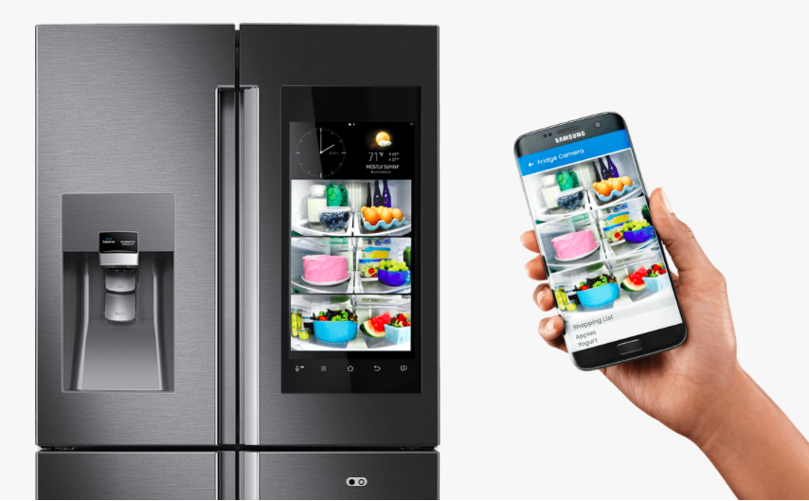
Related work
Some existing refrigerator in the market
Samsung Family Hub refrigerator

Slide 9
Related work
Some technological application
RFID system and method for tracking food freshness
Method for detecting fresh degree of shrimp by electronic nose
Refrigerator food storage and deterioration information detection system and method
Refrigerator with a function to confirm items stored therein

Slide 10
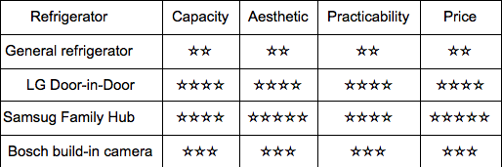
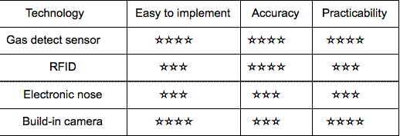
Related work
Competitive analysis table
✫from 1 to 5,represent low to high

Slide 11
Proposed solution
Two Components: Hardware part and Mobile application part
For the hardware part, our sensor integration consists of two parts.
One is we use gas sensor setting in the refrigerator then obtain change of gas. By the investigation and statistics, we found that fruits and vegetables will release ethylene (C₂H₄) in the process of decay. Meat, eggs and milk will release hydrogen sulfide (H₂S) in the process of decay. There have a gas detection sensor can detect these two kinds of gas at the same time.
Another part is used to connect with user’s smart phone. Users can receive the information about food rot in refrigerator via WIFI.

Slide 12
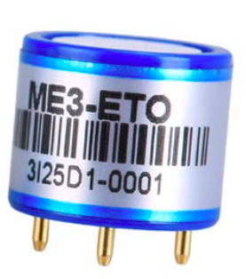
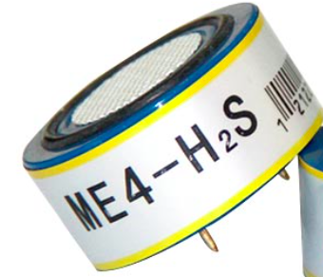
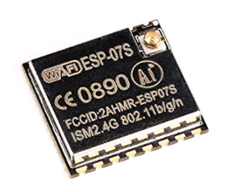
Proposed solution
Two Components: Hardware part and Mobile application part
For the hardware part, our sensor integration consists of two parts.
Minitype USB WIFI: Uses a simple command set to configure and connect to another device. This module allow wirelessly communication to a mobile phone. The operating temperature from -40 ° to 125 °, can run normally in the fridge.
C₂H₄ and H₂S Gas Detector: The operating temperature will be in -20°C- +50°C,so those sensor still can run normally in the fridge.

Slide 13
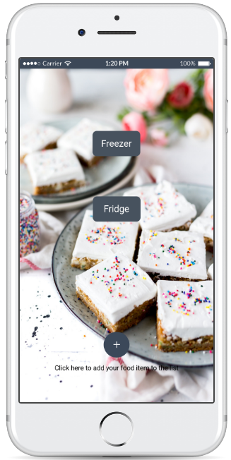
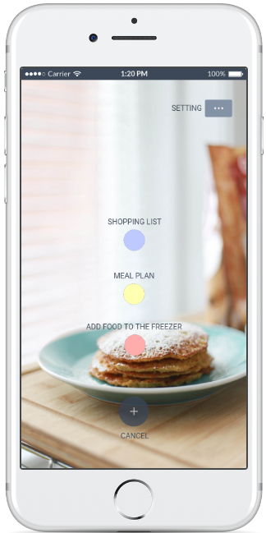
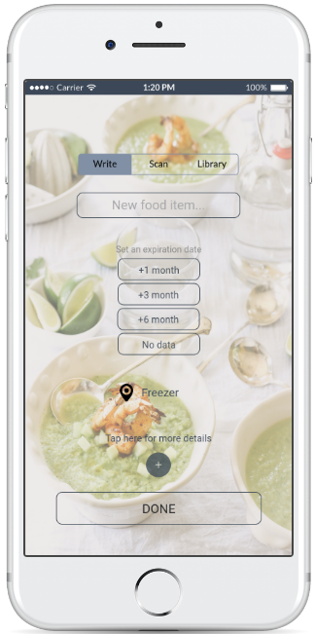
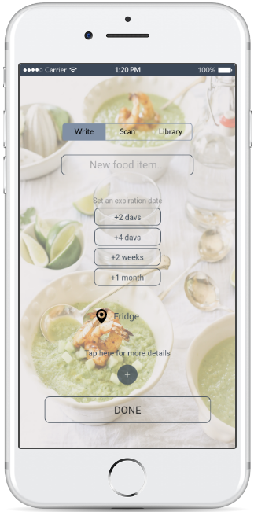
Proposed solution
Two Components: Hardware part and Mobile application part
For the mobile application part, here are some screen mockups.

Slide 14
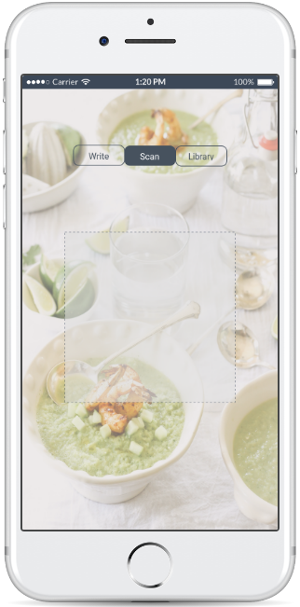
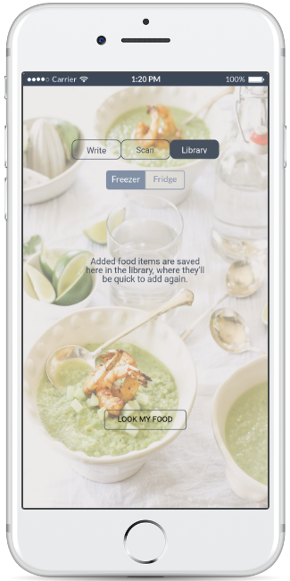
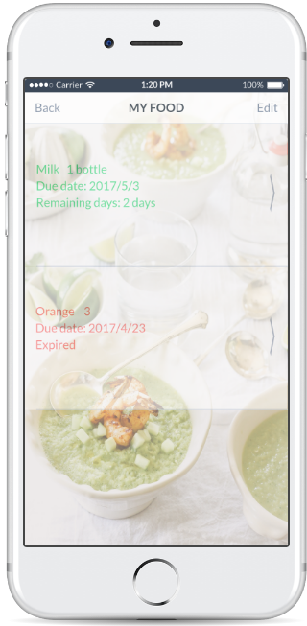

Proposed solution
Mobile application screen mockups

Slide 15


Proposed solution
Mobile application screen mockups

Slide 16
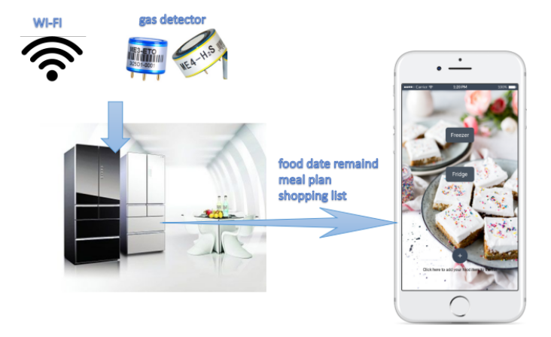
Proposed solution
Prototype

Slide 17
Thank you!

